Slide 1
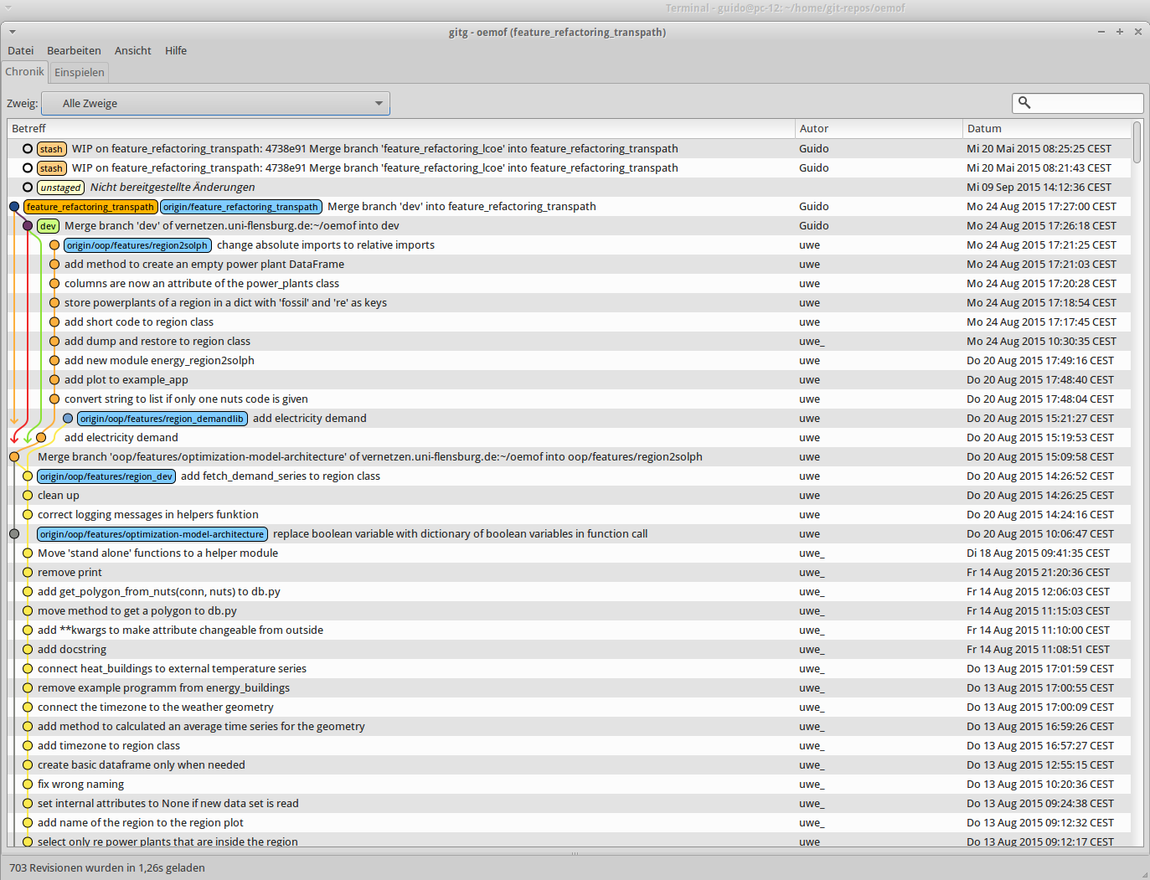
OpenEnergy Platform Requirements to an open source platform for cross-institutional work on energy system models

Slide 2
Background & context
Open Source energy models
Transparency
Reproducibility
Can be re-used by third parties
Collaborative modelling
Clearly defined interfaces & compatible models
Reduces duplicate work
Enhances robustness
Central hub for model code hosting
First approach:
oemof: open energy modelling framework
Funding by project open_eGo
Funded by recently started project open_eGo
Coordinated grid expansion planning of transmission and distribution grid
Based on open source tools

Slide 3
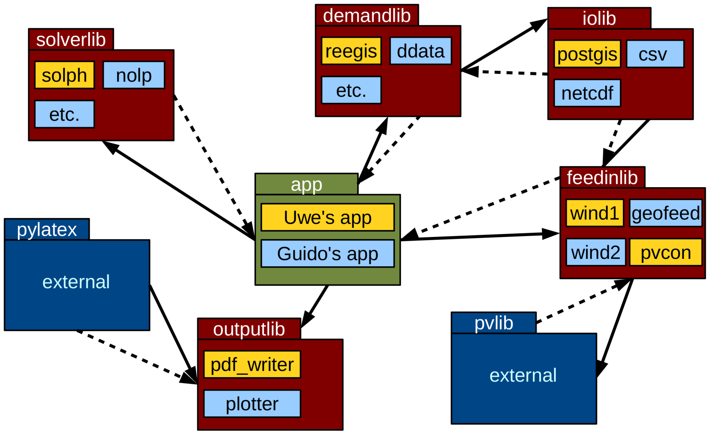

Slide 4
Power & heat dispatch and capacity expansion model
Decision for refactoring to oop
December 2014
August 2015
December 2013
ZNES (Flensburg) joined oemof
Q1 2015
Planned OS release

Slide 5
Contains
Energy system model representing power and heat sector
Dispatch and or capacity expansion optimization
LP formulation
Library for feed-in time series generation
Library for demand time series generation
Database access library
Several apps to build models based on the libraries
Tools
Revision control
git versioning system
embedded in redmine project management
Communication
ticket system
wiki, forum
web conferences
Documentation
readthedocs

Slide 6
Towards the OpenEnergy Platform
OpenMod Workshop (London)
Identifying/ collecting modellers needs
Find interested co-developers
Workshop in Berlin (Oct. 2015)
Present concept based on given needs
Discuss concept and adjust
Implementation
First internal version at begin of 2016
Release in April/May 2016
Implementation of OpenEnergy Platform based on concept

Slide 7
Towards the OpenEnergy Platform
Agenda of Break out group
Models
Interface design
Documentation
Communication
User access
Communication tools
General/ technical
Platform hosting
Maintenance concept
Data
→ Covered by Open Power System Data breakout group

Slide 8
Interested? → join the break out group Conflict with other break out group or you have further interest in a particular aspect → hand over your contact details

