Slide 1
The JRC Dispa-SET unit commitment model
Sylvain Quoilin, Ignacio Hidalgo Gonzalez, Andreas Zucker
Joint Research Center (JRC)

Slide 2
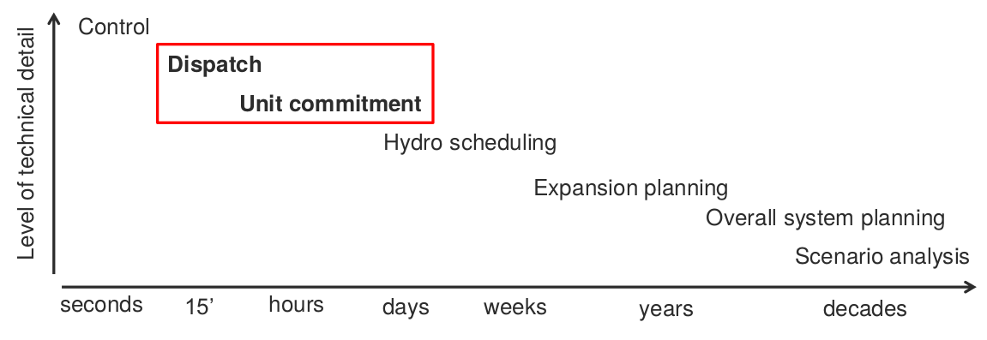
The Dispa-SET model
Unit commitment and optimal dispatch model
MILP formulation
Geographical coverage: whole EU (currently: ES, PT, FR, BE, NL, DE)
Constraints: min/max power, ramping rates, start-up times, min up/down times, interconnection NTC, storage limits, …
Dispa-SET Model
JRC EU-TIMES
JRC (IET)
models:

Slide 3
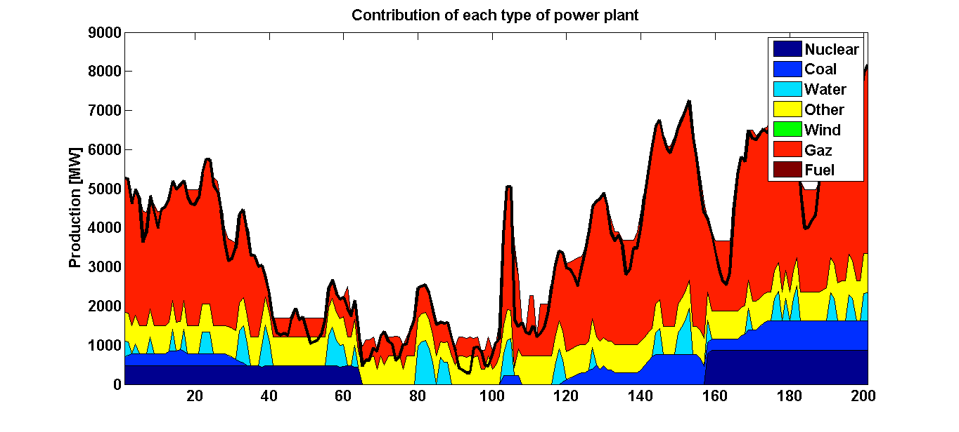
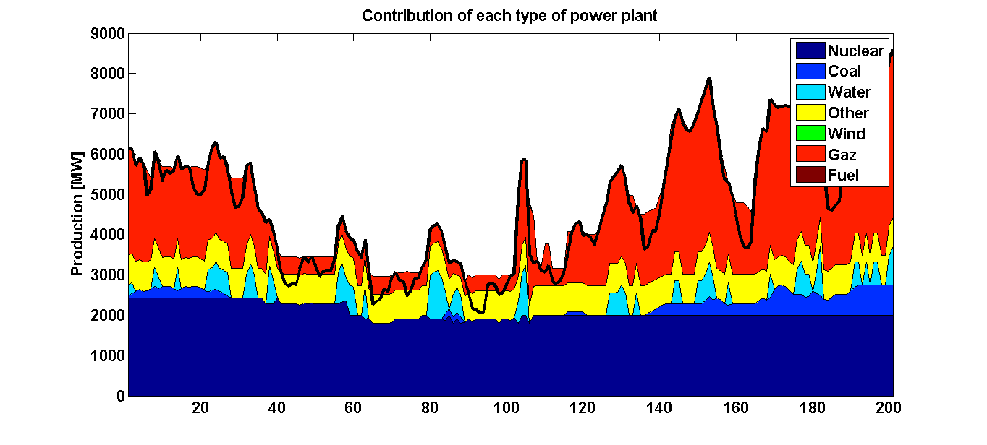
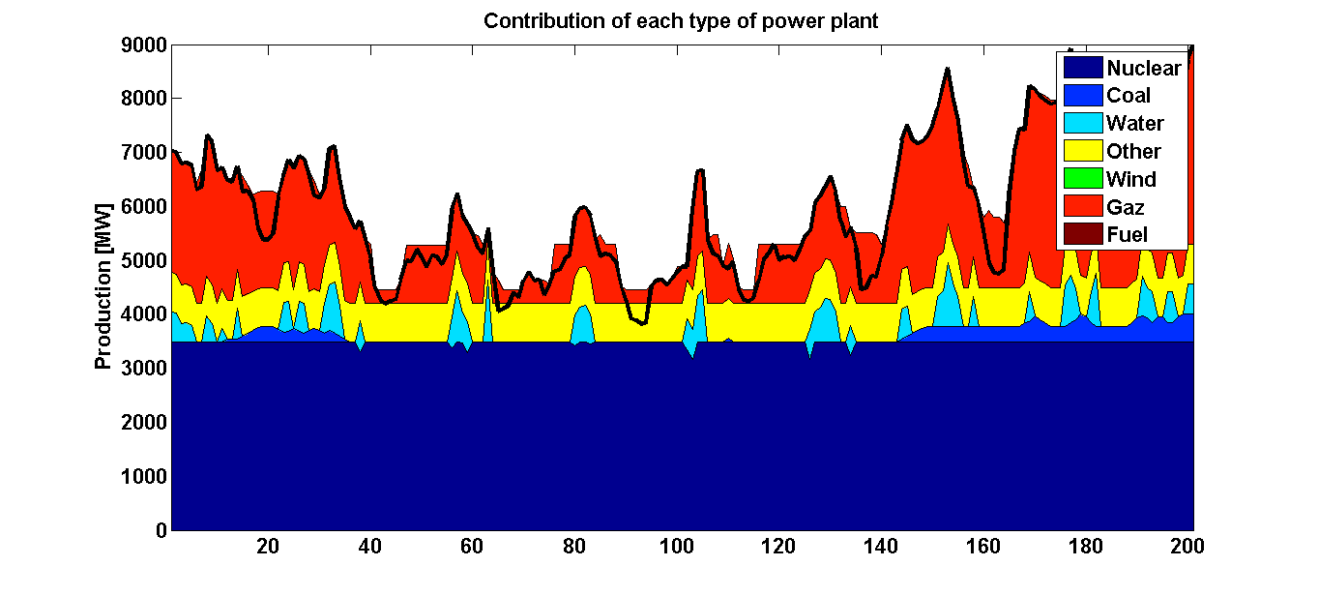
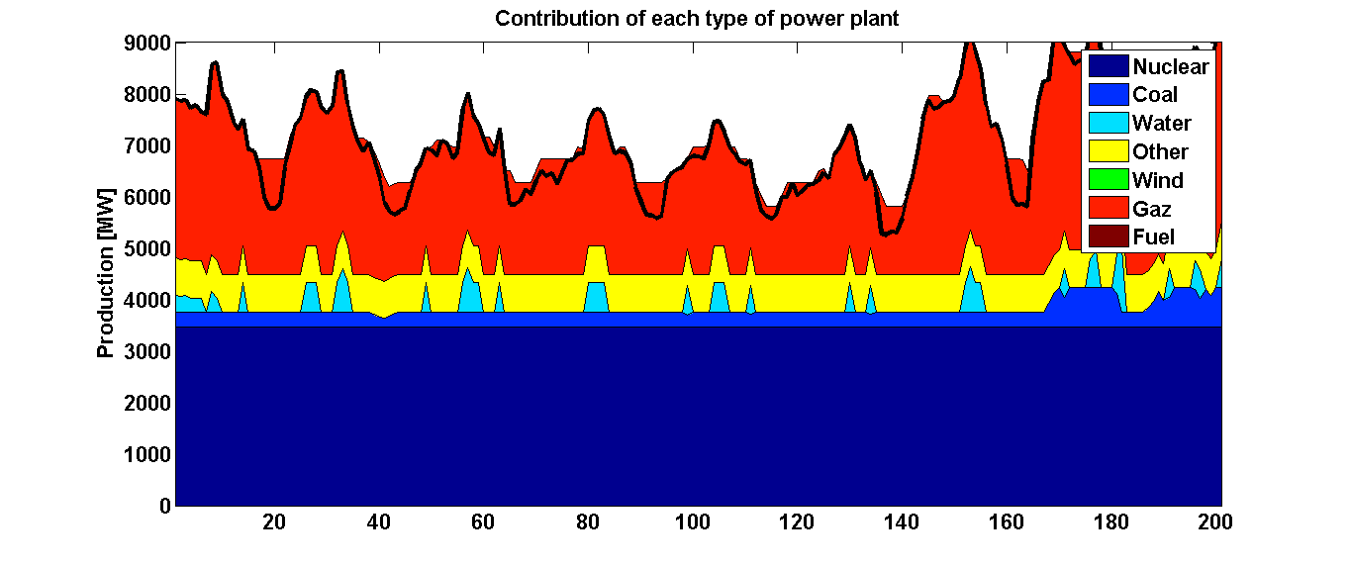
VRE penetration
Insufficient ramping capability

Slide 4
Resolution flow chart
Sim template:
34 Excel sheets (Ignacio’s model)
Raw data: csv sheets from the TSO
Data
Template: Mysql database
Results
template:
1 excel sheet with BOTH the inputs and the results
Sim template:
GDX file
Sim template:
Python Format
Conversion tool:
Python
GAMS
Dos/Batch

Slide 5
Resolution flow chart
Sim template:
34 Excel sheets (Ignacio’s model)
Raw data: csv sheets from the TSO
Data
Template: Mysql database
Results
template:
1 excel sheet with BOTH the inputs and the results
Sim template:
GDX file
Raw data processing:
Read csv sheets, assemble data
Convert to the right format (timestep, units, etc).
Define proper time index (duplicates not allowed)
Connect to database
Check if data present & write data
Write metadata
Sim template:
Python Format
Conversion tool:
Python
GAMS
Dos/Batch

Slide 6
Resolution flow chart
Sim template:
34 Excel sheets (Ignacio’s model)
Raw data: csv sheets from the TSO
Data
Template: Mysql database
Results
template:
1 excel sheet with BOTH the inputs and the results
Sim template:
GDX file
Sim template:
Python Format
Writing the DispaSET template:
Slice the data to the required time range
Deal with missing data
Check data for consistency (min up/down times, startup times, etc.
Calculate variable cost for each unit
Clustering
Define scenario according to user inputs (curtailment, participation to reserve, amount of VRE, amount of storage, …)
Define initial state (basic merit-order dispatch)
Write simulation environment to folder
Conversion tool:
Python
GAMS
Dos/Batch

Slide 7
Resolution flow chart
Sim template:
34 Excel sheets (Ignacio’s model)
Raw data: csv sheets from the TSO
Data
Template: Mysql database
Results
template:
1 excel sheet with BOTH the inputs and the results
Sim template:
GDX file
Sim template:
Python Format
Simulation environment and interoperability:
Self-consistent folder with all what is needed for a simulation:
Excel files
GDX file
Gams model files
Python files
Possibility to modify the template manually and re-generate GDX file in DOS or in Python
Dos script is automatically generated by python for all variables
Conversion tool:
Python
GAMS
Dos/Batch

Slide 8
Resolution flow chart
Sim template:
34 Excel sheets (Ignacio’s model)
Raw data: csv sheets from the TSO
Data
Template: Mysql database
Results
template:
1 excel sheet with BOTH the inputs and the results
Sim template:
GDX file
Sim template:
Python Format
Simulation:
The GAMS simulation file must be run from the created simulation folder
All results and inputs are written to an excel file
The DispaSET model can also be run in Python, using Pyomo and CPLEX (seems faster than GAMS, to be confirmed)
Conversion tool:
Python
GAMS
Dos/Batch

Slide 9
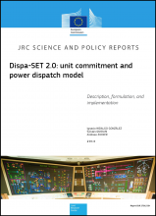
Open questions
Defining a public, open-source dataset
Timing of open-source release
Licencing

