Slide 1
Power system modelling using high spatial- and temporal-resolution wind data
10-11 September 2015
Thomas Spitz^{1,*}, Alasdair Bruce^{1,*},Gareth Harrison¹, Hannah Chalmers¹, Mathieu Lucquiaud¹
¹School of Engineering, University of Edinburgh, The King’s Buildings, Edinburgh, EH9 3JL, UK
T.Spitz@ed.ac.uk , Alasdair.Bruce@ed.ac.uk
Notes:
So, as I said in the introducion I haven‘t done any power system modelling myself, but I would like to present a couple of points on behalf of my collegue Alasdair Bruce.
I will first give a very brief overview over his work, but basically the presentation is about making you aware that there is a very detailled wind dataset for the UK that we have and that we are willing to share with anybody that is interested.

Slide 2
Outline
Developed a UCED model for near future UK power system scenarios
Considered:
Carbon Capture & Storage
Energy Storage
High penetration of wind power
Main focus:
Detailled wind resource data for 386 existing and potential wind sites (onshore and offshore)
Non-linear correlation between wind speeds and power outputs!
Notes:
So that‘s Alasdair. He has developed a unit commitment economic dispatch model for the UK for future power system scenarios. He considered Carbon Capture and Storage, Energy Storage and high penetrations of wind power in the system.
His main focus was on basing the model on very detailled wind resource data. That‘s because he figurred out that due to the non-linear correlation between wind speeds and wind farm power output he wouldnt be able to capture the wind power potential of the UK adequatly relying on low resolution or averaged wind speed data.

Slide 3
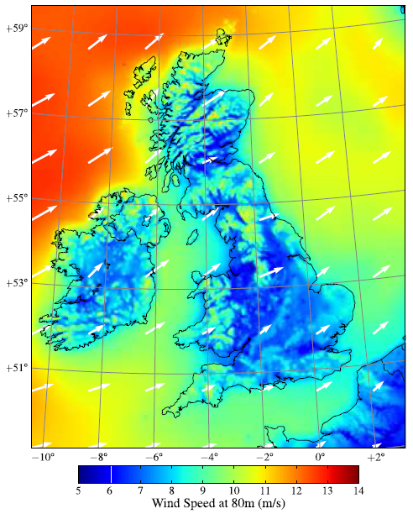
Wind reanalysis dataset
Large historical dataset of existing and potential wind sites
11 years 2000 to 2010
1 h temporal resolution
3 km x 3 km spatial resolution
High spatial- and temporal-resolution wind resource model [1]
Weather Research and Forecast (WRF) modelling system
Fully-compressible, non-hydrostatic mesoscale model
Pressure based terrain-following coordinate system
Calibrated using large number of in-situ meteorological observations
UK MET office data, wind farm masts, buoys, light ships, oil platforms, radar profilers and satellites
Temporally matched with electricity demand data
Hourly and seasonal variations in electricity demand and wind output
Fig. 1. Average wind speeds at 80 m above ground level between 2000 and 2010.
[1] S. Hawkins, D. Eager, and G. P. Harrison, 2011, “Characterising the reliability of production
from future British offshore wind fleets”, Renewable Power Generation (RPG 2011)
Notes:
That‘s the wind reanalysis dataset we have and Alasdair ended up using. It has a temporal resolution of 1 hour and a spatial resolution of 3km and it relies on historial data of 11 years and a fully-compressible, non-hydrostatic mesoscale model. It is terrain following and it has been calibrated extensively using all kinds of sources. Importantly it can be temporally matched with electriciy demand data, which is of course necessary for working out the reserve and capacity requirements of the grid.
The dataset is on here. So if anybody wants it he can have it.

Slide 4
Aims
Study impacts of increasing penetration of wind energy utilisation on power system operation
Thermal power plant operating regimes, start-up requirements
CO₂ capture and storage flexibility and performance characteristics & requirements
Energy storage utilisation
Cost impacts
CO₂ emissions
Matlab & Excel
Software
Notes:
Alasdair had several aims when carrying out the work. Most importantly he wanted to study the operating regimes of future fossil power plants and the flexibility and performance requirements of the future CO2 capture and storage infrastructure. That‘s also where I will continue his work.
The software he used is Matlab & Excel.
Thanks.

